Slide 1
SMOTE
Synthetic Minority Over-sampling Technique – a methodology to handle class imbalance problems.
Synthesis of new minority class instances
Over-sampling of minority class
Under-sampling of majority class
Tweaking the cost function to make misclassification of minority instances more important than misclassification of majority instances

Slide 2
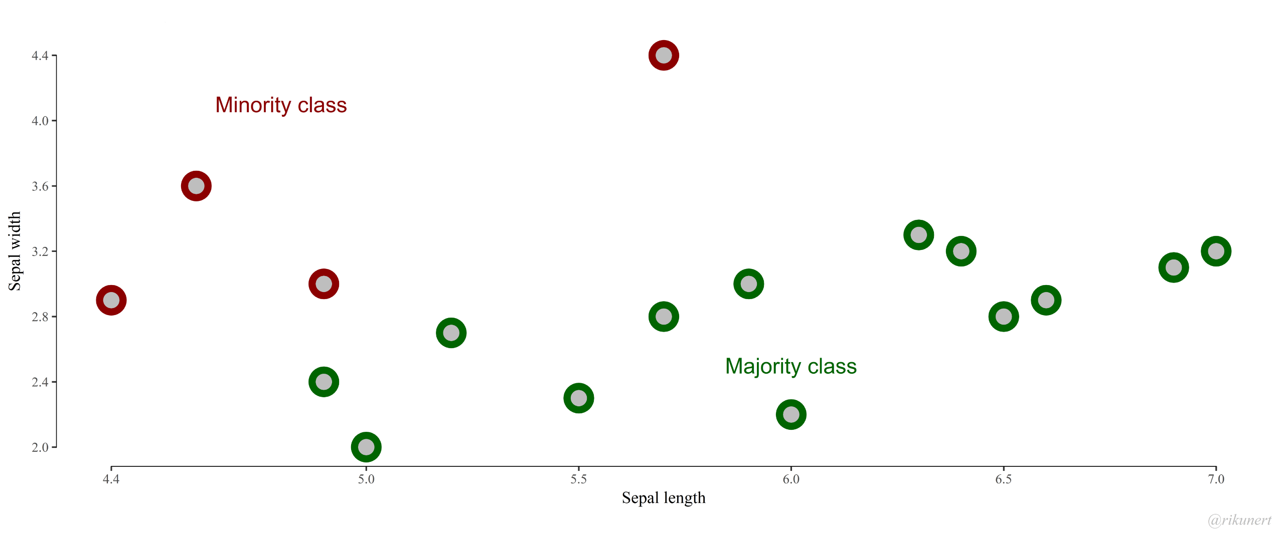
SMOTE

Slide 3
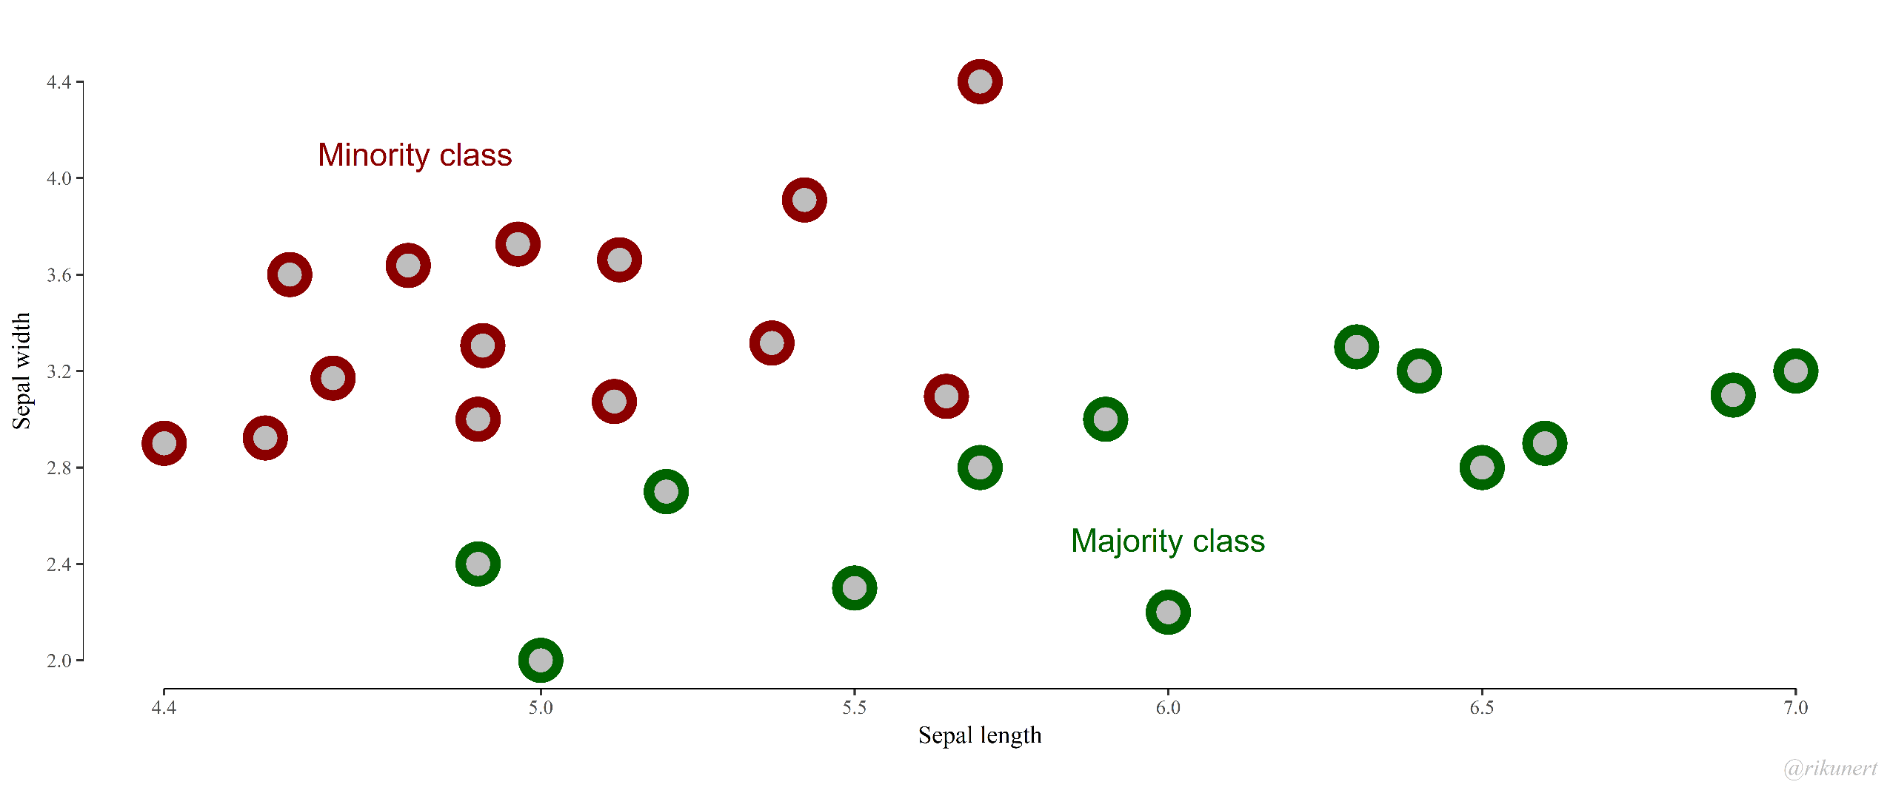
SMOTE
The trade-off between recall (percent of truly positive instances that were classified as such) and precision (percent of positive classifications that are truly positive). In situations where we want to detect instances of a minority class, we are usually concerned more so with recall than precision

Slide 4
K-Fold Cross-validation
Cross-validation is a resampling procedure used to evaluate machine learning models on a limited data sample.
1. Shuffle the dataset randomly
2. Split the dataset into k groups
3. For each unique group:
a. Take the group as a hold out or test data set
b. Take the remaining groups as a training data set
c. Fit a model on the training set and evaluate it on the test set
d. Retain the evaluation score and discard the model
4. Summarize the skill of the model using the sample of model evaluation scores
Think of this as the leave one out technique

Slide 5
K-Fold Cross-validation
Choosing k
A poorly chosen value for k may result in a misrepresentative idea of the skill of the model, such as a score with a high variance (that may change a lot based on the data used to fit the model), or a high bias, (such as an overestimate of the skill of the model).

Slide 6
K-Fold Cross-validation
Basic example
Let’s assume we have six observations:
[1, 2, 3, 4, 5, 6]
Now, let’s use k = 3, so we need to create three random folds:
fold 1: [5, 2]
fold 2: [4, 6]
fold 3: [3, 1]

Slide 7
K-Fold Cross-validation
Basic example
fold 1: [5, 2]
fold 2: [4, 6]
fold 3: [3, 1]
So our train and test sets become:
train: [5, 2, 4, 6], test: [3, 1]
train: [4, 6, 3, 1], test: [5, 2]
train: [3, 1, 5, 2], test: [4, 6]

